Slide 1




Ai In Educations
Presented by: Khushi Hirapara
Enroll No. : 23002171310055
Branch : CST

Slide 2

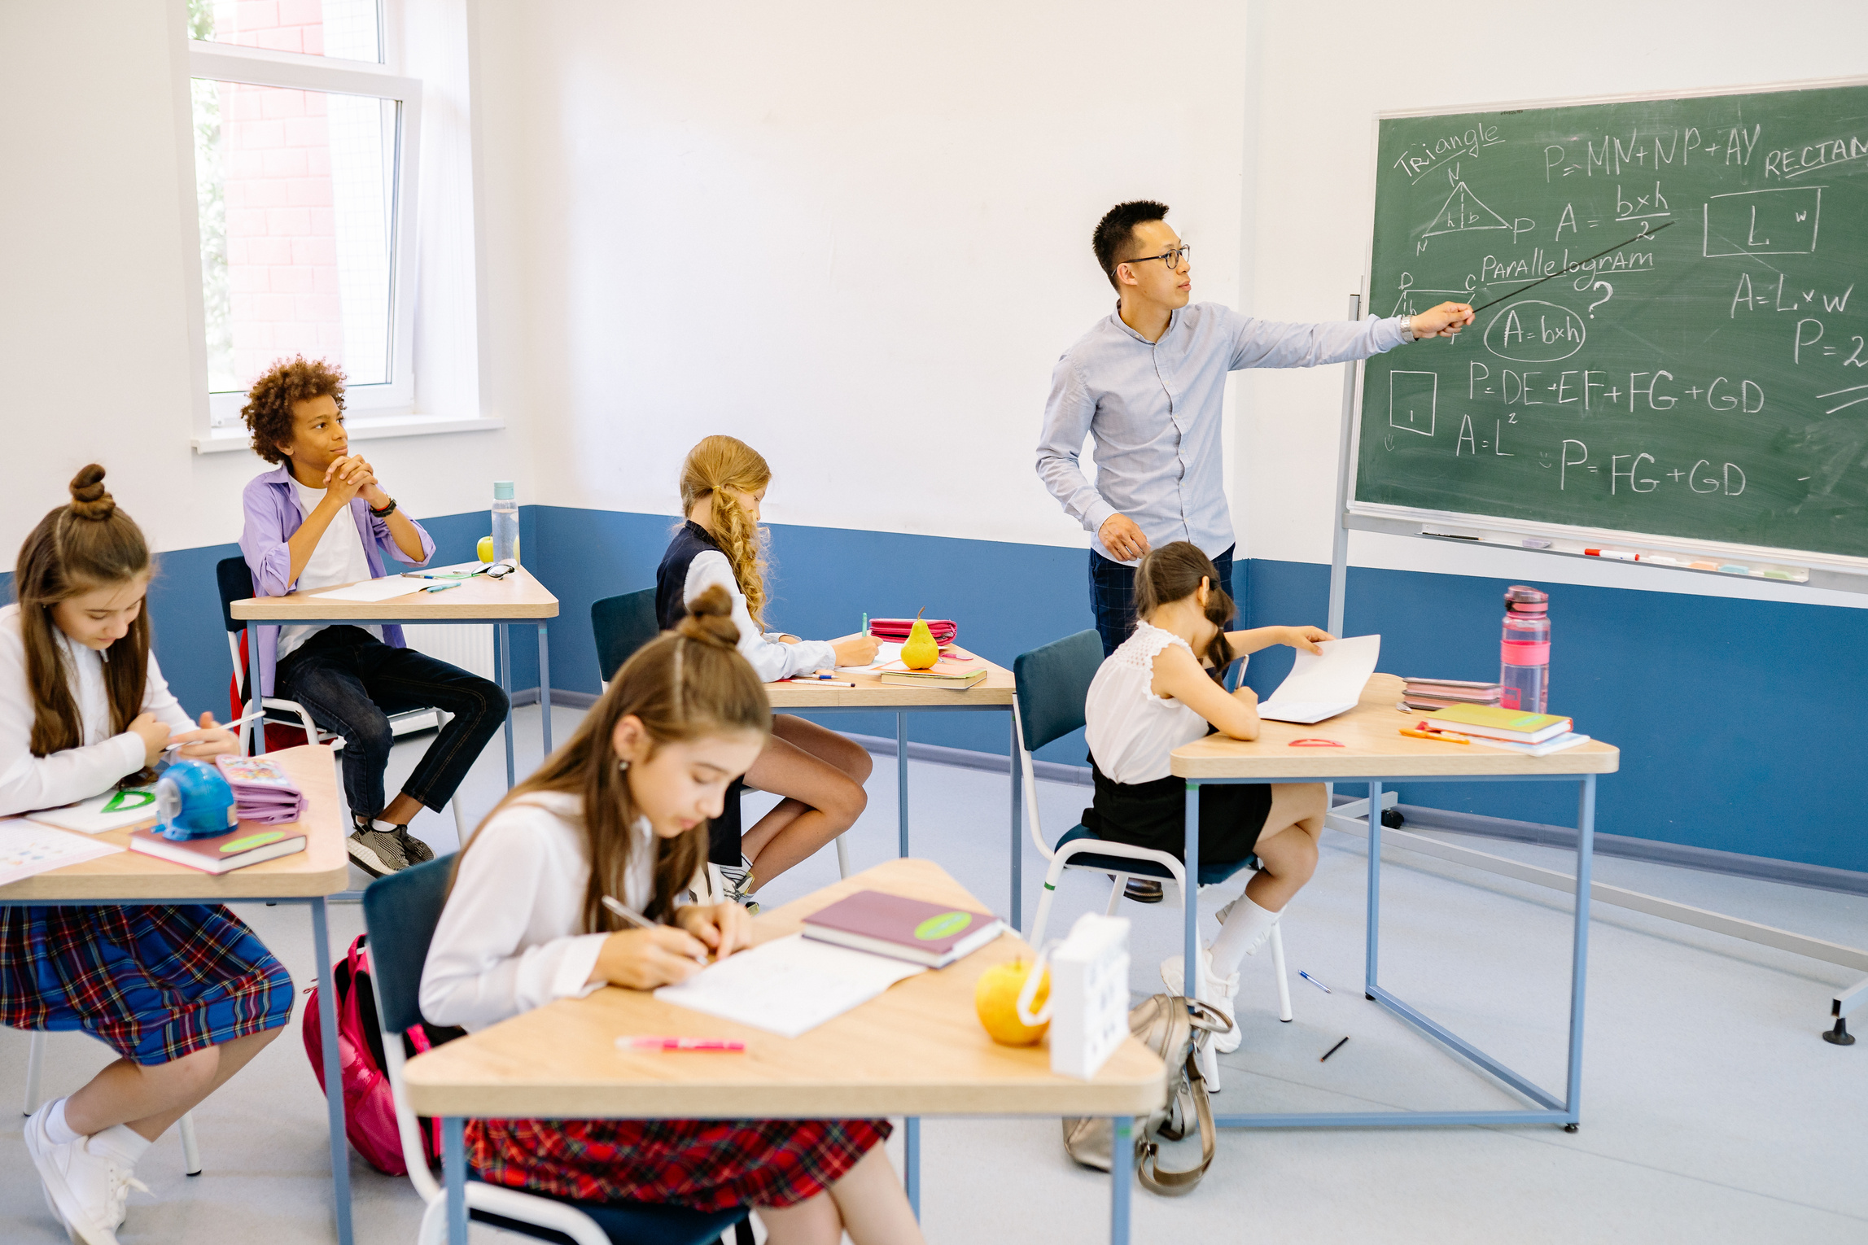

What is AI?
Artificial Intelligence (AI) is technology that enables computers to learn, think, analyze, and make decisions like humans.
  Learn from data
  Understand human language
  Recognize images and voice
  Solve problems quickly
  Automate repetitive tasks

Slide 3


How AI is Transforming Education
  Personalized learning for every student
  24×7 AI tutors and study support
  Instant feedback on assignments
  Language translation and accessibility
  Track student progress with analytics

Slide 4

  24/7 Learning Support – Students can learn anytime and anywhere.
  Accessible Education – Supports translation, speech-to-text, and students with disabilities.
  Cost-Effective Learning – Many AI learning tools are free or affordable.
Benefits of AI Learning
  Instant Feedback – Quick answers and assignment evaluation.

Slide 5



Challenges & Solutions
AI offers many benefits, but it also brings challenges that require responsible use and continuous improvement.
Digital Skills
Improvement
  Not everyone has access to devices or high-speed internet.
  Responsible AI
Use AI ethically with human guidance and regular monitoring.
Data Security & Privacy
Ethical AI
  Student data must be protected from misuse.
  AI should be fair, transparent, and free from bias.

Slide 6



Future of AI Educations
  Smart classrooms
  Intelligent virtual tutors
  Personalized study plans
  AI-powered language learning

Slide 7
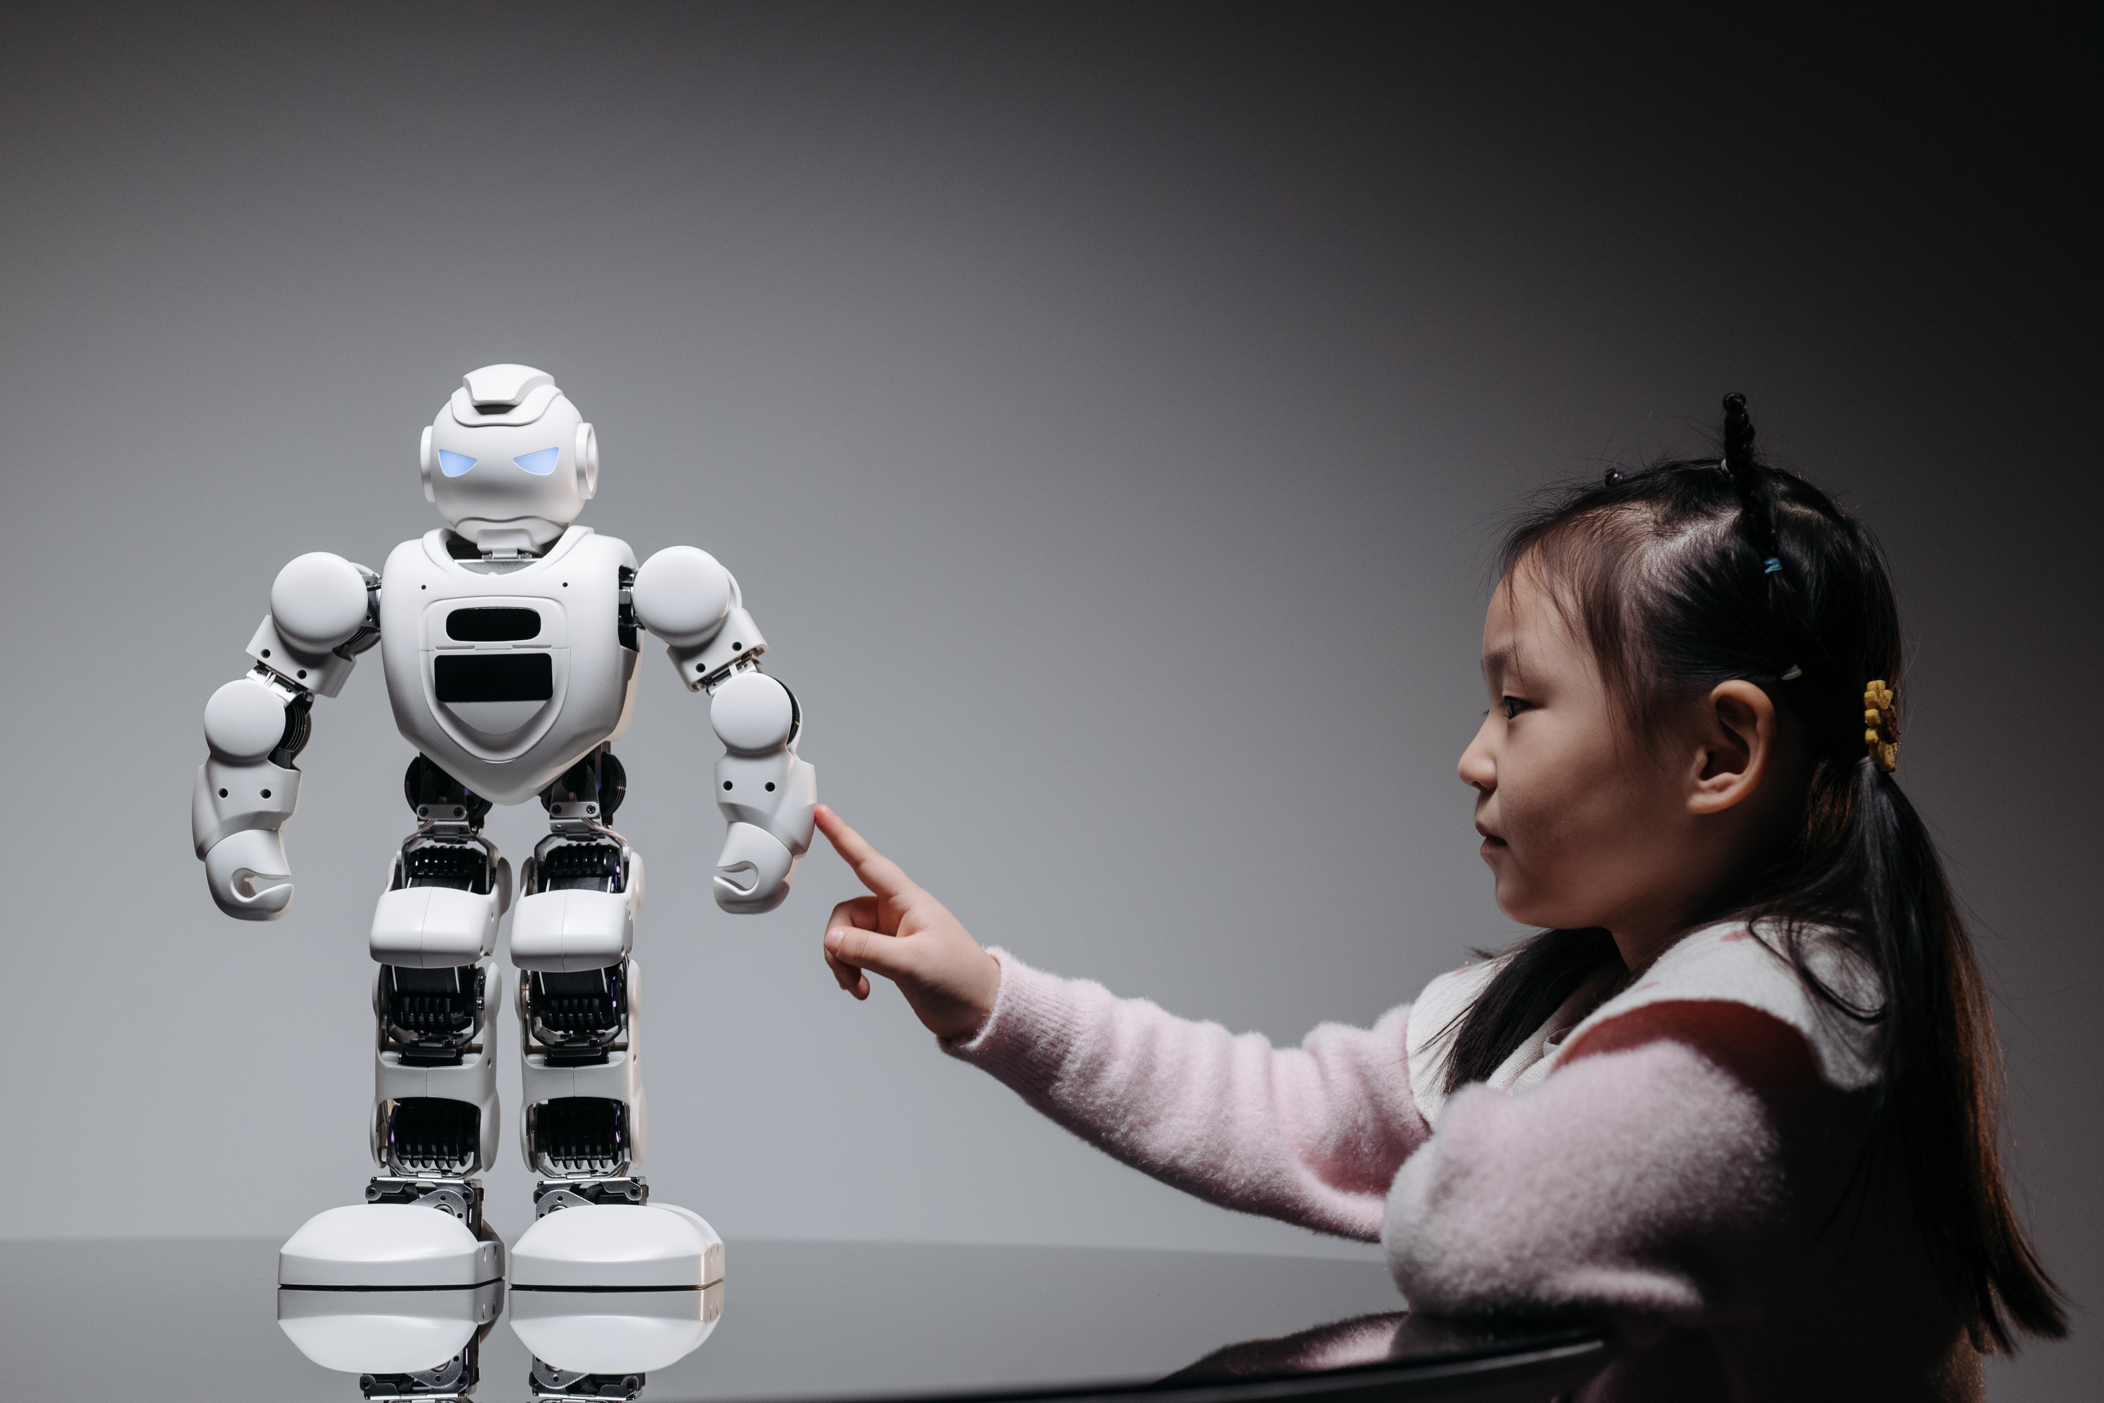

Thank You

